Slide 1

Web Development 1
© Hugh McCabe & Matt Smith 2008-2014
Lecture 4b
CSS class selector

Slide 2
Introduction
All CSS rules look as follows:
selector {
declaration(s);
}
Simplest rules use HTML element names as selectors e.g.
p {font-size: small; }
h1 {color: red; }
Disadvantage is that property values specified in declaration will apply to all occurrences of element.
So, all paragraph text is small, all h1 headings red.

Slide 3
Introduction
What if we want to make just one heading red?
Or make one paragraph in small font, the others in medium?
There are a number of different selector types that allow us to do exactly this.
Today we’ll look at a third kind of CSS selector:
Element selector
Group selector (using the comma)
Class selectors
Descendant selectors

Slide 4
CSS Class
– full stops
li.irish {
color: green;
}

Slide 5
Class - HTML
The class selector, can be used to associate similar elements together
and style them accordingly
Means we can apply one style rule to multiple elements of the same class
Only those elements declared as being in that class
<!-- HTML class attribute in tag -->
<strong class="daily_offer">50% sale</strong>
HTML attribute ‘class’ declares an element to be a member of the named class
Can then be styled in CSS

Slide 6
Class - CSS
To construct a style rule for strong elements of the daily_offer class write:
strong.daily_offer {
background-color: yellow;
}
The dot (.) symbol used to indicate class name in CSS rule selector
NOTE: NO SPACE either side of the DOT !!!!!!

Slide 7
Class - Example
Suppose for example we are building a website for a shop that sells books, CDs and DVDs.
The entire catalogue appears on one page but the client wants the three categories of item to look different in some way.
Solve this by defining three classes – CD, book and DVD.
Then for each item, specify which class it belongs to.
See example on next slide.

Slide 8
Class
The HTML fragment
<ul>
<li class=“book”>No Country For Old Men</li>
<li class=“book”>The Gathering</li>
<li class=“cd”>Ok Computer</li>
<li class=“book”>The Mission Song</li>
<li class=“dvd”>Seinfeld Season 1</li>
</ul>
The CSS to style each class of list item differently
li.book { color: green; }
li.cd { color: navy; }
li.dvd { color: orange; }

Slide 9
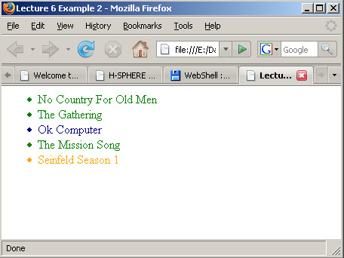
Class Selectors
li.book { color: green; } /* books in GREEN */
li.cd { color: navy; } /* CDs in NAVY BLUE */
li.dvd { color: orange; } /* DVDs in ORANGE */

Slide 10
Anonymous Class
– full stops
.irish {
color: green;
}

Slide 11
The “anonymous class”
Can apply a rule to all elements of class
Regardless of what type of element they are
For example suppose we have list item elements specified as being of class “book” i.e.
<li class="book">The Mission Song</li>
But in other places on the page also have anchor (a) elements specified as being of class book i.e.
<a href=".." class="book">The Gathering</a>
The following style rule will colour both red:
.book { color: red; }

Slide 12
Example classes in real page – multi-column footer

Slide 13
Generic Elements – div and span
HTML
Other page content here ...
<!–- multi-column footer →
<footer>
<section class="left">
(left content here)
</section>
<section class="middle">
(middle content here)
</section>
<section class="right">
(right content here)
</section>
</footer>
A common use of this is to identify the various sections of a web page e.g.

Slide 14
Generic Elements – div and span
CSS
/* -------- multi-column ----- */
footer {
display: flex;
}
footer section {
flex: 1;
}
/* --------- text alignment ------- */
.middle {
text-align: center;
}
.right {
text-align: right;
}

Slide 15
Generic Elements – div and span
CSS
/*
make sections in border look nicer
- add border and some padding ...
*/
footer section {
flex: 1;
border: 1px solid black;
padding: 0.5rem;
}

Slide 16
Summary and Conclusions

Slide 17
Summary / Conclusions …
Class: style all elements of a class
HTML write ‘class’ attribute in opening tag: <li class="book”>content </li>
CSS Select with element and dot: e.g. li.book { ... }
Can use anonymous class selector – so can style DIFFERENT elements of the given class
Selector with just dot . e.g.
.book { ... }
TIP – most of the time anonymous is all you need …

